Slide 1
​​ The Finland Education System
By Natalia

Slide 2
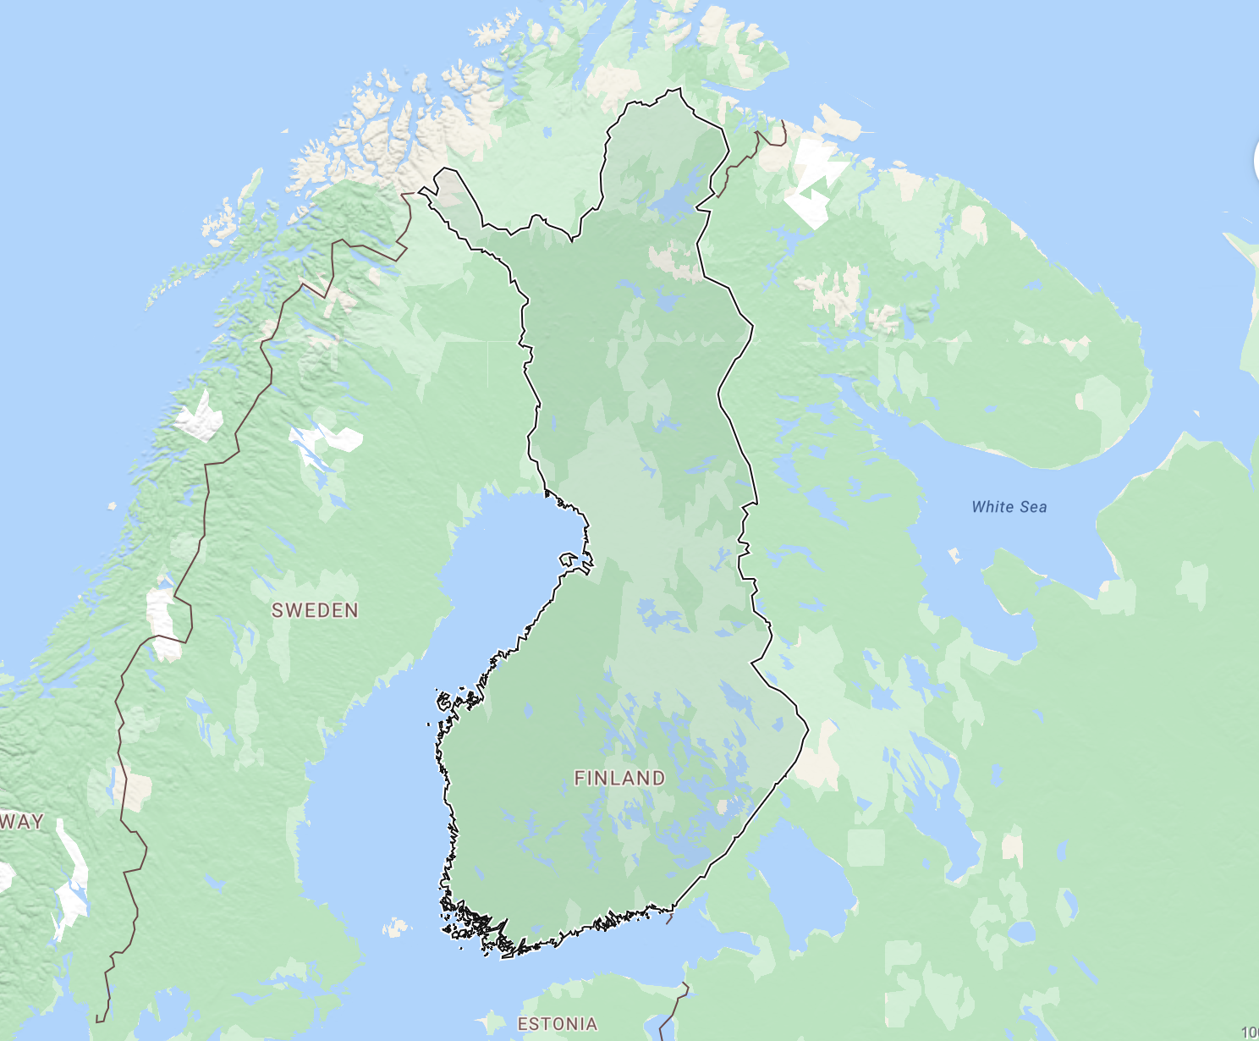
About Finland
- Finland is a country in Northern Europe, located near Sweden and Russia. It has a cold climate with long winters and many forests, and its capital city is Helsinki.
- Finland has a population of about 5.5 million people and is known for valuing equality, education, and strong community connections. The main languages spoken are Finnish and Swedish, and the country is a democratic republic.
- Finland also has a high GDP and strong infrastructure, including well funded schools and healthcare systems. These factors help support its successful education system and lower levels of inequality compared to many other countries.

Slide 3
The Global Issue
The Global issue is education inequality and how systems affect students success.
Not all students around the world have equal access to good education.
Some countries use more testing, longer school days, and strict grading.
This can increase the poverty cycle, because students with less education may have fewer opportunities.
Education affects a countries GDP, development, and future success.
Finland use a different system with:
Less testing and homework.
Play-based learning in early years.
More focus on quality.
Big question:
Can Finland’s education system work in other countries like Canada, or does it depend on Finland’s strong infrastructure and society?

Slide 4
Challenges and criticisms of Finland's education system
Although Finland’s education system works well, it has some downsides. One issue is that with less testing and fewer grades in the early years, it can be harder to clearly track student progress. Some students might also struggle without structure or competition, especially if they are used to more traditional school systems.
Another problem is that Finland’s system might not work well in other countries. It depends on strong government funding, highly trained teachers, and a culture that values equality and trust. Countries that don't have have the same level of infrastructure or resources could find it difficult to copy this system.
There is also a concern that students may not be fully prepared for more competitive environments later on, like university or jobs in places that focus more on exams and performance.

Slide 5
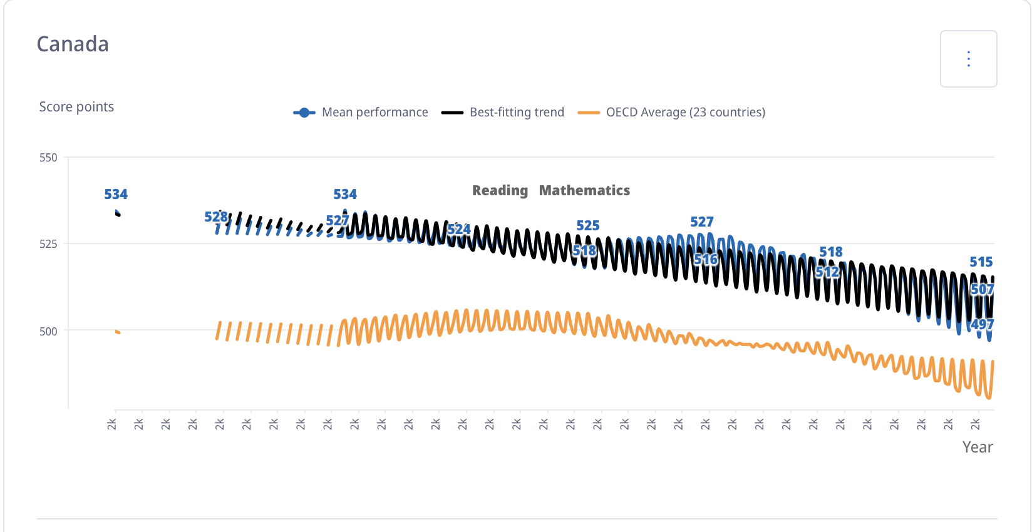
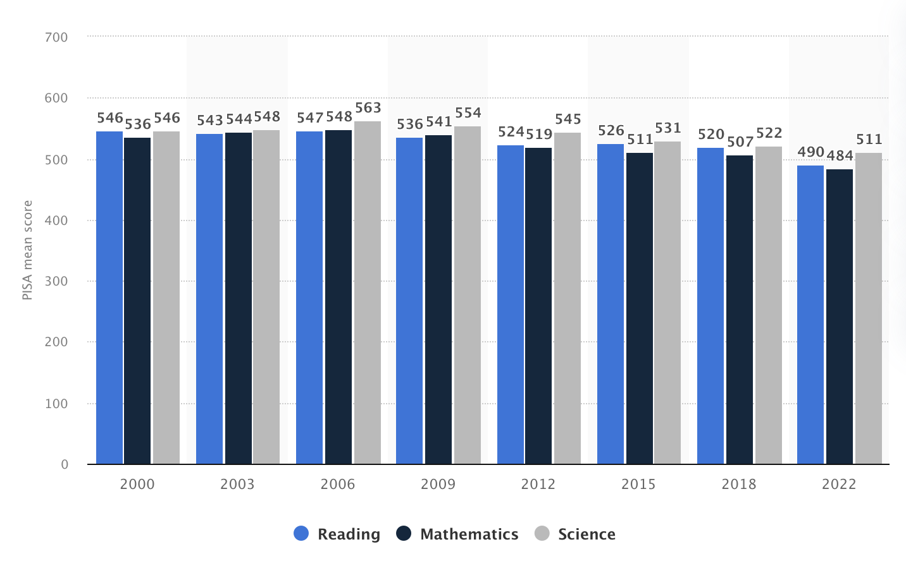
Canada & Finland Reflection
Both Canada and Finland have strong education systems, but when you look at the data, you can see that both countries PISA scores have gone down over time. In Canada, scores dropped from around 534 to below 500, which is a pretty noticeable change. Finland has also seen its scores decline, especially in recent years.
This shows that even countries that do really well in education are starting to face challenges. Canada should care about this because it scores are also going down, not just Finland’s. Instead of copying Finland completely, Canada can learn from what works, like focussing on students well-being, well improving its own system. This is important because systems need to keep changing to meet students needs.
PISA 2022 Results (Volume I and II) ‑ Country Notes: Canada
PISA student performance in Finland from 2000 to 2022, by subject and score

Slide 6
Thank you
Sources:
Wikipedia. (August 2021). Educational inequality. Retrieved from https://en.wikipedia.org/wiki/Educational_inequality
Statista. (2000-2022). PISA student performance in Finland from 2000 to 2022, by subject and score. Retrieved from https://www.statista.com/statistics/986919/pisa-student-performance-by-field-and-score-finland/?srsltid=AfmBOoqYLOKjOBk7sAaUtfS4YUdDBo7OHZXO7ns8GMmU9oqGVx65_Qe3
europa. (2023). Finland snapshot. https://op.europa.eu/webpub/eac/education-and-training-monitor/en/country-reports/finland.ht
l
Kyle. (2023). Ministry report: Finnish education levels stagnant, learning outcomes in 'rapid decline'. https://yle.fi/a/74-20012522
OECD. (2025). Education at a Glance 2025: Finland. https://www.oecd.org/en/publications/education-at-a-glance-2025_1a3543e2-en/finland_d8f44a5b-en.htm
l
OECD. (2022). PISA 2022 Results (Volume I and II) ‑ Country Notes: Canada. https://www.oecd.org/en/publications/pisa-2022-results-volume-i-and-ii-country-notes_ed6fbcc5-en/canada_901942bb-en.html
Smithsonian magazine. (2011). Why Are Finland’s Schools Successful?. https://www.smithsonianmag.com/innovation/why-are-finlands-schools-successful-49859555/

